Slide 1
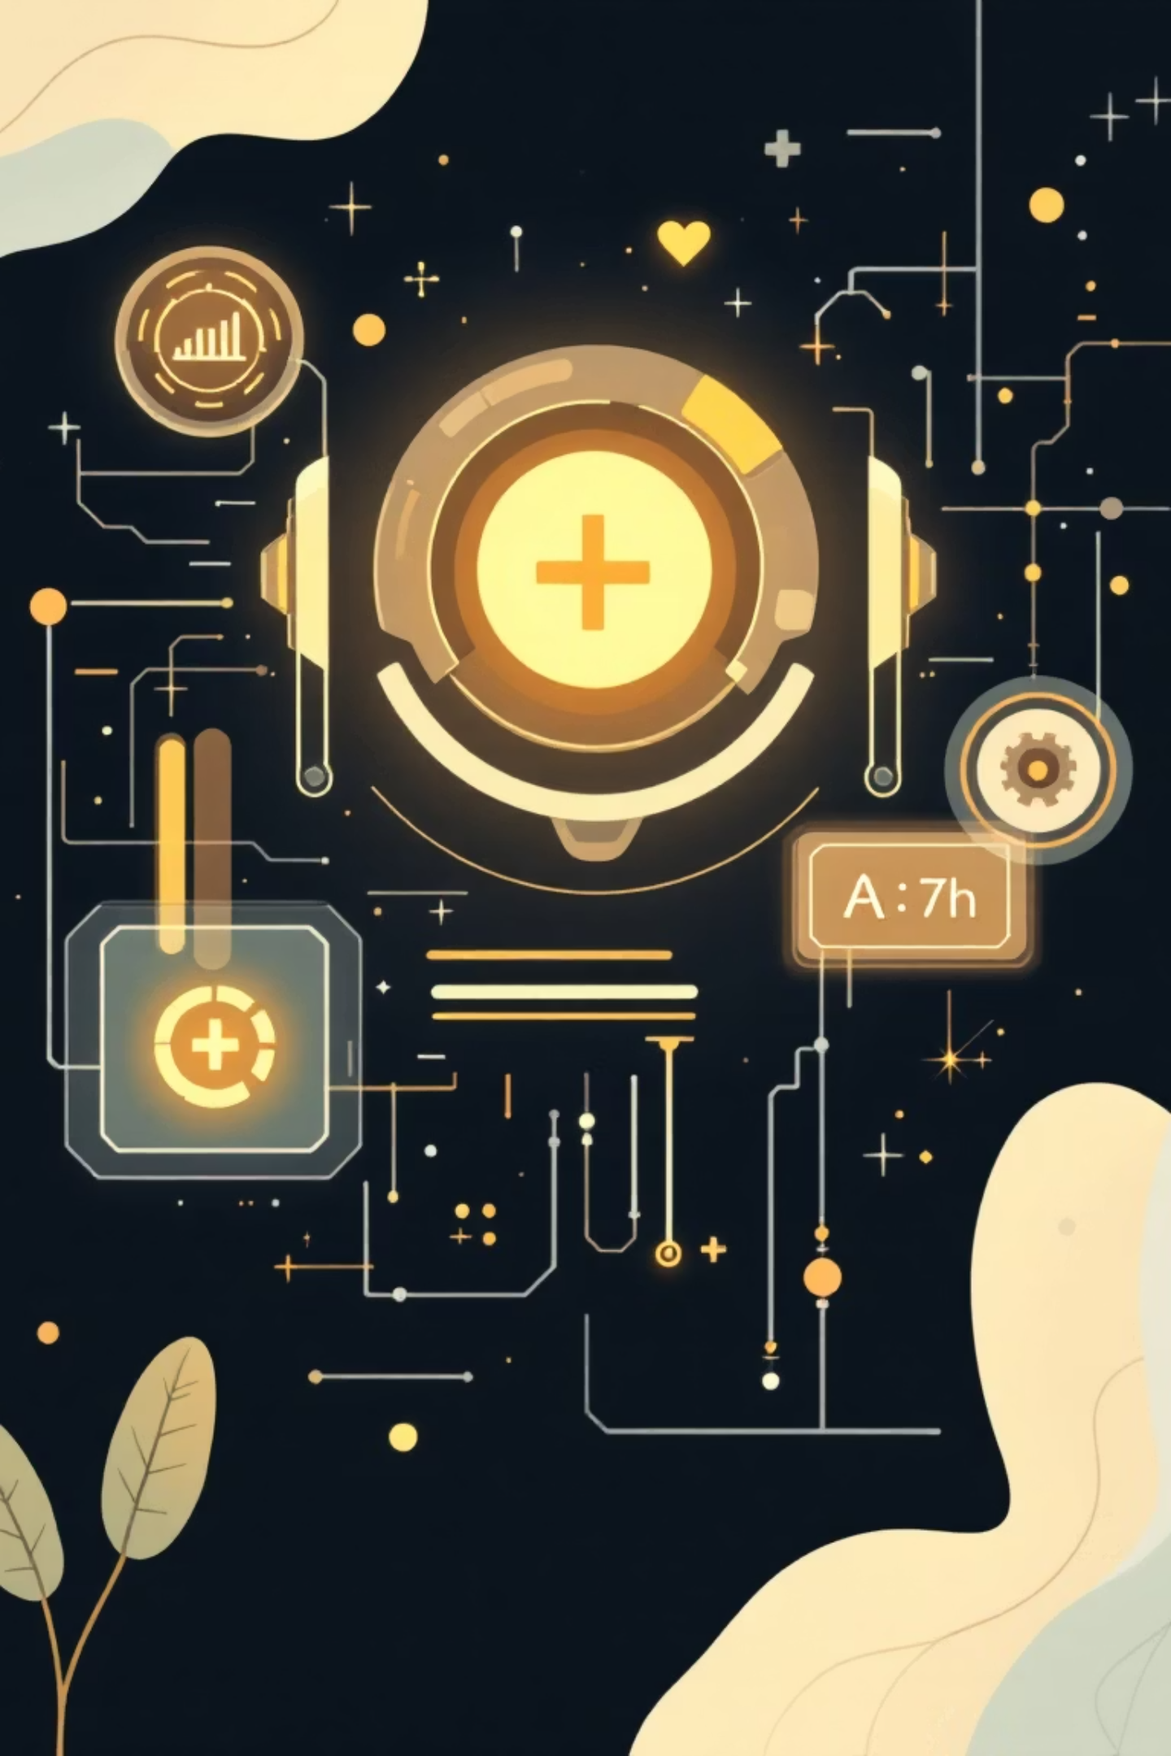
REECE AI
The "Super-Rep" for Modern Pharma
Plaksha MediThon 2026 | Track 2: Digital Medical Representative

Slide 2
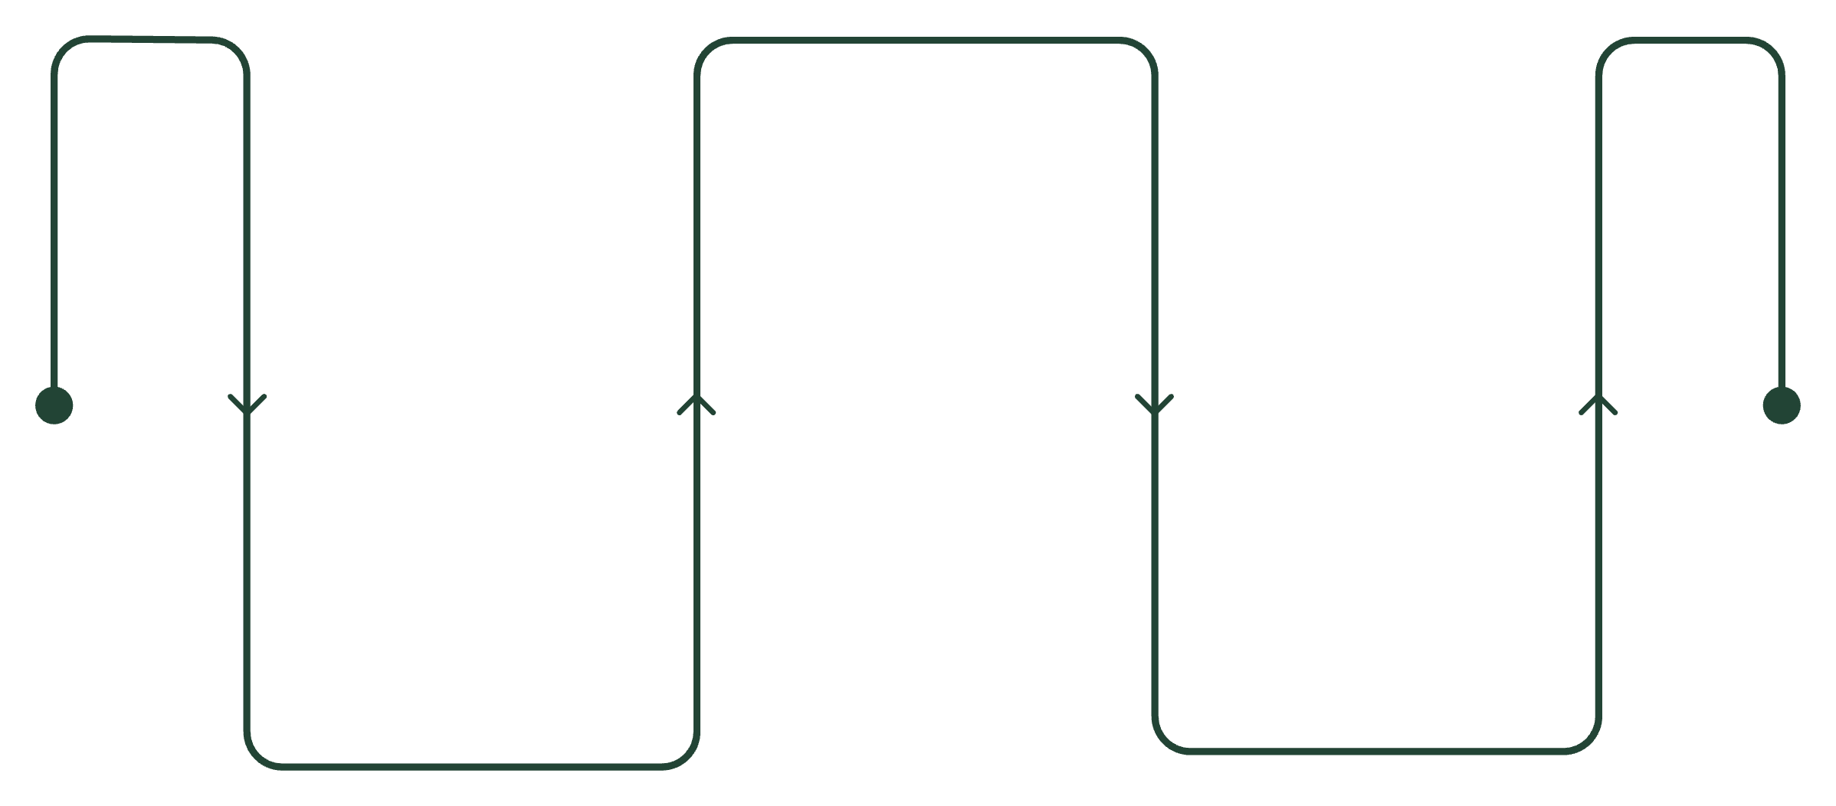
Executive Summary: The "Super-Rep" Flow
Paeon AI is an end-to-end clinical assistant designed to revolutionize patient communication, drug differentiation, and education.
Differentiate
Highlight drug-specific benefits and risks
Translate
Educate
Convert patient slang to clinical history
Deliver clear patient-facing guidance
1. Translate
2. Differentiate
3. Educate
Converts patient slang into clinical history for accurate diagnosis.
Compares generic vs. brand-name drug nuances for informed decisions.
Generates instant, personalized visual flashcards to boost adherence.
Our goal: A working prototype bridging patient experience and clinical precision.

Slide 3


The Problem: Bridging Critical Disconnects
Our Objectives
Standardize
Language Barrier
Achieve 100% accurate Slang-to-MedDRA mapping.
"My head is spinning" (Slang) vs. "Vertigo" (Clinical). Misinterpretation leads to errors.
Clarify
Provide transparent "Brand vs. Molecule" comparisons.
The "Generic" Myth
Engage
Crucial differences in excipients or absorption rates are often ignored.
Enable "Just-in-Time" creation of localized patient flashcards.
Low Adherence
Patients forget verbal instructions, and generic pamphlets are discarded, impacting outcomes.

Slide 4

Target Market & Beneficiaries
Primary Users
Beneficiaries (Patients)
1
2
General Practitioners (GPs)
Pharmacists
Vulnerable Populations
Market Impact
To explain _why_ a specific brand was chosen over a generic.
Addressing the ₹2 Lakh Crore Indian Pharma Market, focusing on chronic disease adherence.
For quick history-taking and precise drug differentiation.
Elderly or non-native speakers who struggle with standard medical instructions.

Slide 5
Competitive Analysis: Our Unique Edge
Paeon AI stands apart by offering an integrated, end-to-end solution focused on critical nuances often missed by competitors.
Key Competitors
Our USP: The Nuance Engine
1
Epocrates / 1mg
Strong for static data, but lacks "Slang Translation" or "Nuance Comparison."
Deeper Insights
End-to-End Workflow
2
Generic LLMs (ChatGPT)
We highlight bioavailability, excipient allergies (e.g., lactose), and price in a single view.
Seamless integration from Intake to Prescribe to Educate for comprehensive care.
Prone to medical "hallucinations" and lacks "Fair Balance" safety protocols.
Key Weakness
Dependency on accurate, up-to-date excipient data.

Slide 6



Technical Architecture: The 3-Step Engine
Our robust architecture leverages cutting-edge AI and data management to power the "Super-Rep" capabilities.
1. Slang-to-Clinical Layer (Input)
2. Nuance & RAG Engine (Processing)
3. Flashcard Generator (Output)
Tech: OpenAI GPT-4o / Gemini 1.5
Tech: Vector DB (Pinecone) + JSON Excipient Database
Tech: Python Pillow library + DALL-E 3
Function: Maps "I have the runs" to "Diarrhea (Acute)."
Function: Creates visual infographics (Sun/Moon icons) in the patient's native language.
Function: Compares brands (e.g., _Brand A_ dissolves in 20m vs. _Brand B_ in 45m).

Slide 7

Budget & Resources: Pilot Costs
A strategic investment of $65,000 is projected for our pilot phase, ensuring robust development and compliance.
Infrastructure ($20k)
Data Acquisition ($30k)
Compliance ($15k)
High-speed LLM tokens for real-time translation and image generation.
Licensing detailed excipient/bioavailability data from lab partners.
"Fair Balance" audits to meet CDSCO/FDA norms for generated flashcards.

Slide 8
Strategic Roadmap: From Hackathon to Scale
Our phased approach ensures rapid development, rigorous testing, and seamless integration into clinical workflows.
Month 1
Month 6
The Hackathon: Build "Slang Translator" and basic "Brand Nuance" JSON DB for 5 key drugs.
Scale & Integrate: Integrate with existing EMR systems for one-click usage and broader adoption.
1
2
3
Month 3
Pilot Deployment: Deploy "Flashcard Generator" in 2 partner clinics to test patient adherence.

Slide 9

Conclusion: Empowering the Future of Pharma
Paeon AI redefines the Medical Rep, transforming them from a "salesperson" into an indispensable "clinical partner."
Impact For Doctors
Impact For Patients
1
Faster, More Accurate History Taking
1
Safer Choices (Allergy-Aware)
2
Clear, Understood Instructions
2
Enhanced Prescribing Confidence
Our vision: A world where every prescription comes with perfect understanding.

Slide 10
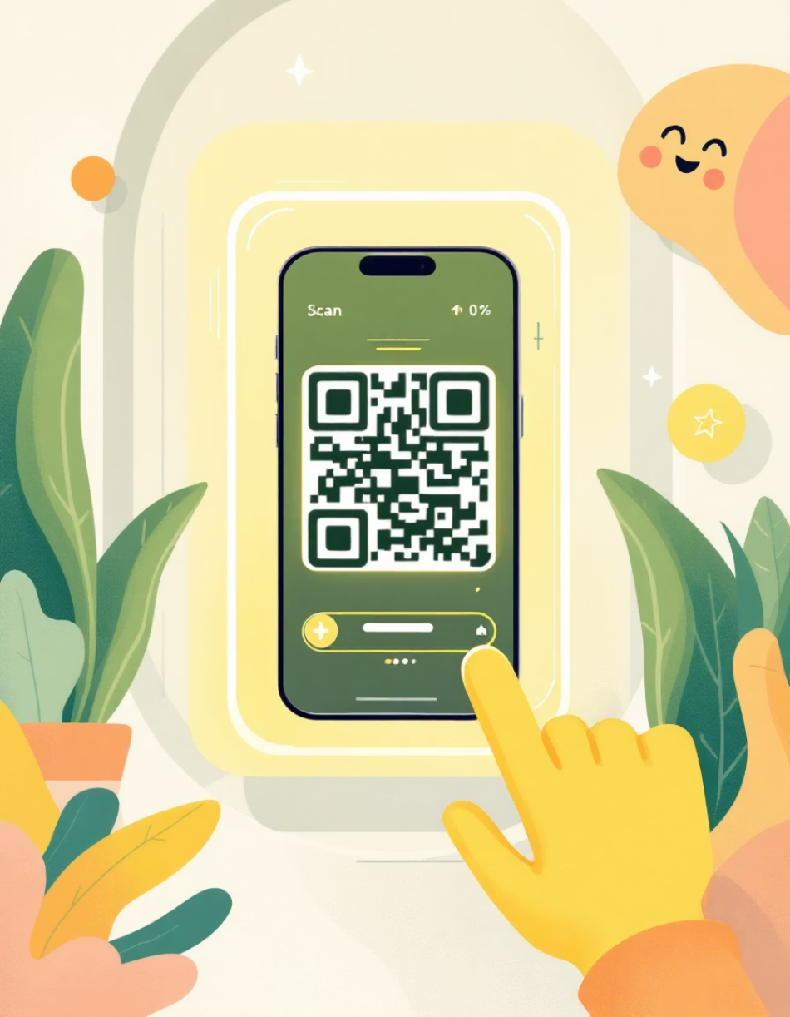
Connect With Us
We invite you to explore the future of digital medical representation.
Team Paeon AI
Demo Link
Email
Aadi Batra
[Insert Hosted URL]
hello@reece.ai
Marutey Mani
Suchetan PH
Swapneel Premchand
Scan to see the "Nuance Engine" live.

